Slide 1
總統
代表聯邦
總統由各州選出「選舉人(Elector)」，由「選舉人」選舉總統、副總統
各州「選舉人」名額依該州所分配之聯邦參、眾議員總額合計；
除50州以外，首府華盛頓 District of Columbia 比照最小州分配「選舉人」名額3名；但華府以外，其他5個未建州的屬地並無總統選舉人名額
選舉人總額為100+435+3=538人，當選最低票數為選舉人票過半數 = 270 票

Slide 2
J.1總統選舉的方式
(一)依據憲法規定，總統、副總統係間接選舉。
各州依所分配名額(該州參眾議員人數合計)選出總統選舉人，由選舉人選舉正副總統。
(二)各政黨總統候選人在各州均提出該州全額的選舉人名單，彼此係整批名單包裹競爭。
(三)凡獲得最高選民票的總統候選人，其政黨所屬的該州選舉人名單即包裹當選。
但Maine 及 Nebraska 兩州選舉人係分開計票，依原選區劃分(參議員選區為全州、眾議員Maine 分2區，Nebraska分3區)分別計票。

Slide 3
(四)各州選舉人選出後在州政府所在地投票，每一選舉人投二票，分別選舉正副總統。
選舉人票隨即送至華府，在國會開票，以獲過半數(270票)者當選。
(五)若無人獲過半數票，遂由眾議院選舉總統，參議院選舉副總統。
但眾議院選舉總統係以州為單位投票，
參議員選舉副總統則仍為一人一票。

Slide 4
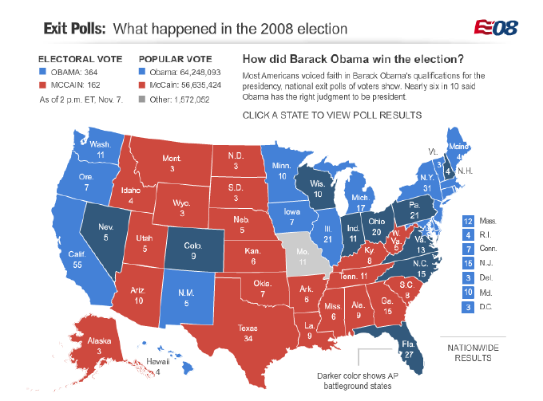

Slide 5
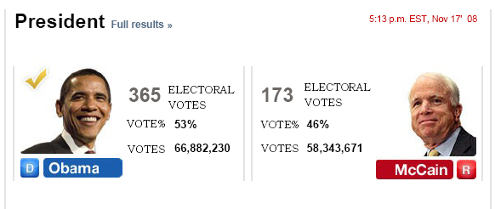
Election 2008 Final Results

Slide 6
Make That 365: Obama on Track to Pick Up Nebraska Electoral Vote
President-elect Barack Obama appears likely to add one more electoral vote to his already decisive total, thanks to a passel of outstanding ballots that were counted today in Nebraska's 2nd Congressional District.
The Omaha World-Herald called the race in the heavily metropolitan district in Obama's favor after election officials began counting early and provisional ballots in Douglas County.
…. http://voices.washingtonpost.com/44/2008/11/07/make_that_365_obama_on_track_t.html?hpid=topnews

Slide 7
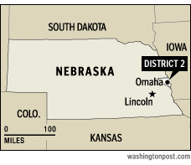

Slide 8
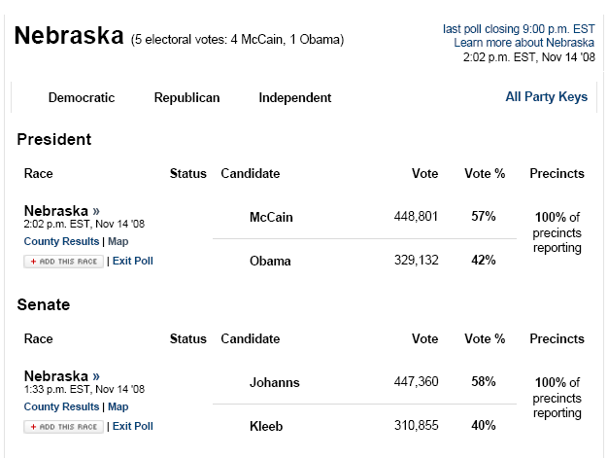

Slide 9
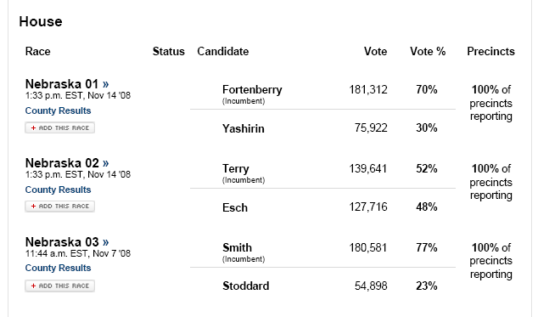

Slide 10
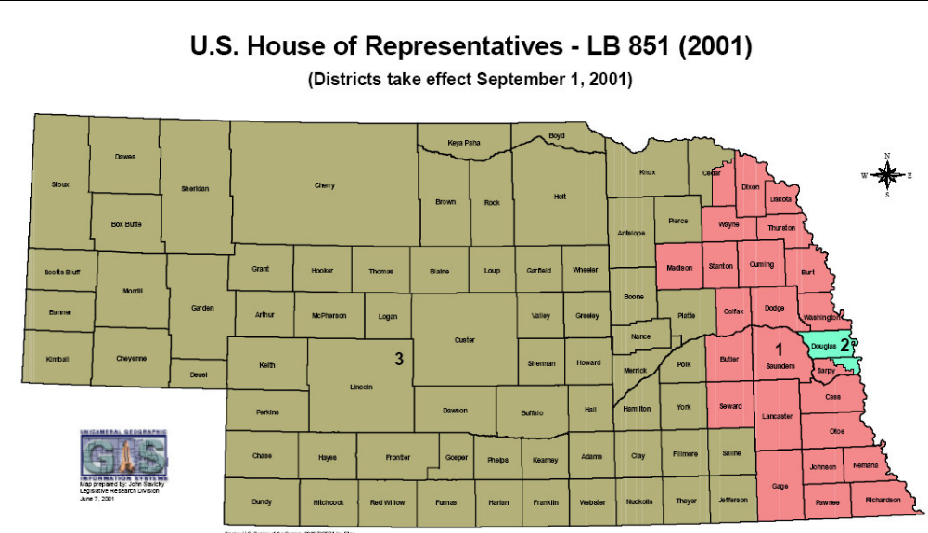
Nebraska Congressional Districts

Slide 11
Federal Offices For President of the United States
 | John McCain | Barack Obama | Chuck Baldwin | Cynthia McKinney | Bob Barr | Ralph Nader
 | Republican | Democrat | Nebraska | Green | Libertarian | By Petition | Write In
TOTAL | 452979 | 333319 | 2972 | 1028 | 2740 | 5406 | 2837
Congressional District One | 148179 | 121411 | 1024 | 394 | 922 | 1963
Congressional District Two | 135439 | 138809 | 599 | 320 | 1014 | 1628
Congressional District Three | 169361 | 73099 | 1349 | 314 | 804 | 1815

Slide 12
United States Senator
 | Mike Johanns | Scott Kleeb | Kelly Renee Rosberg | Steven R. Larrick
 | Republican | Democrat | Nebraska | Green
TOTAL | 455854 | 317456 | 11438 | 7763
Member of the U.S. House of Representatives
District One | Jeff Fortenberry | Max Yashirin
 | Republican | Democrat
TOTAL | 184923 | 77897
District Two | Lee Terry | Jim Esch
 | Republican | Democrat
TOTAL | 142473 | 131901
District Three | Adrian Smith | Jay C. Stoddard
 | Republican | Democrat
TOTAL | 183117 | 55087

Slide 13
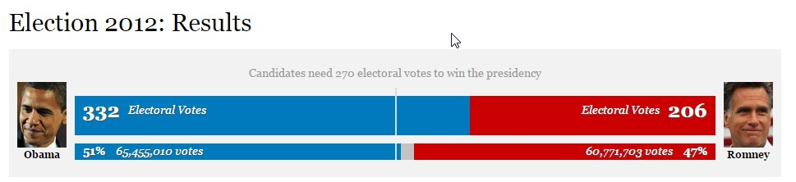
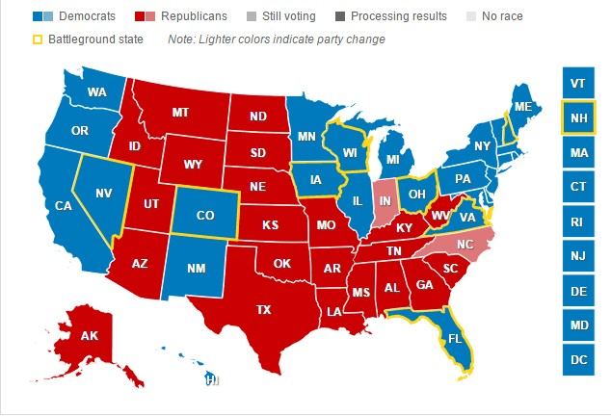

Slide 14
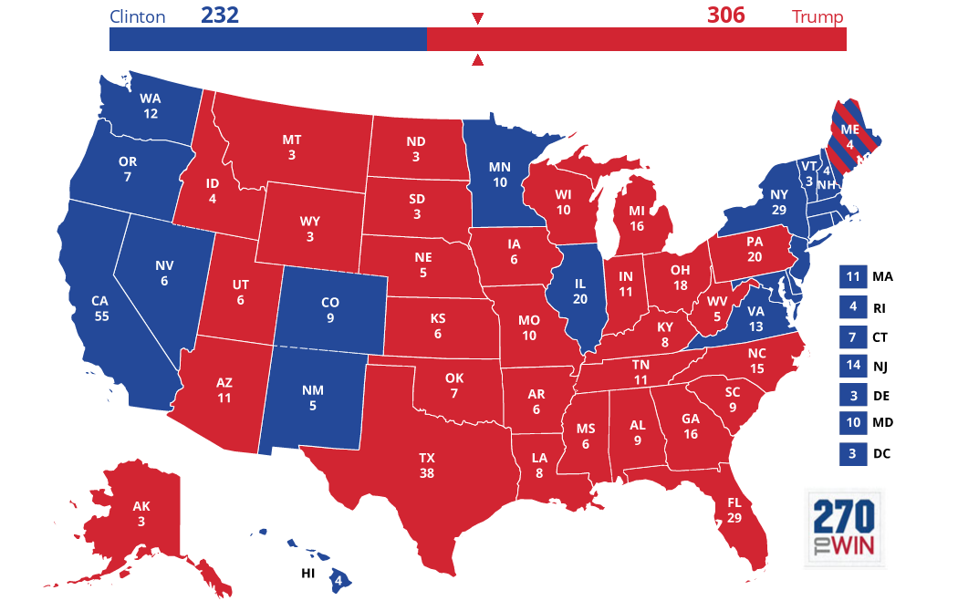
Election 2016 11/8/2016

Slide 15
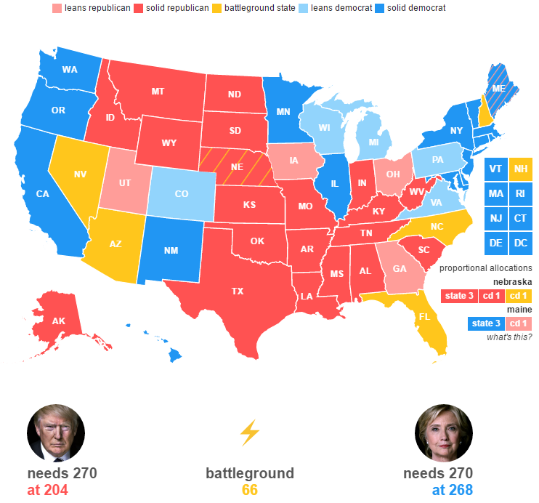

Slide 16
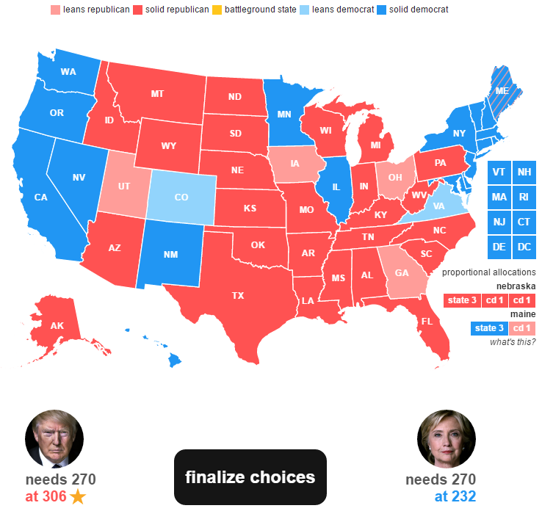

Slide 17
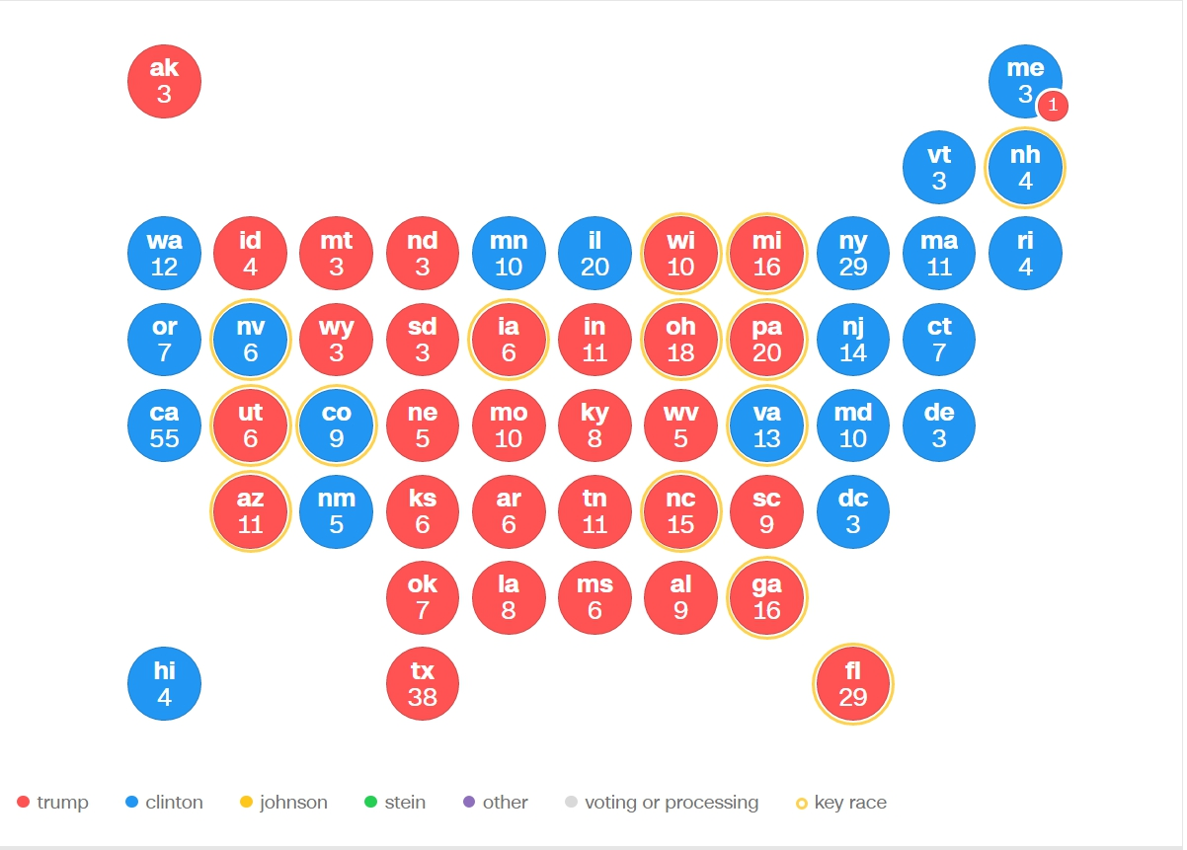

Slide 18
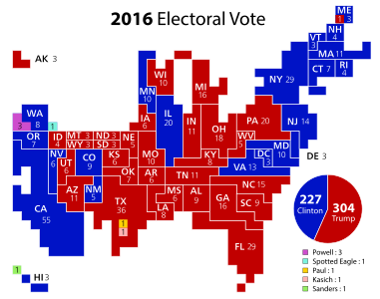

Slide 19
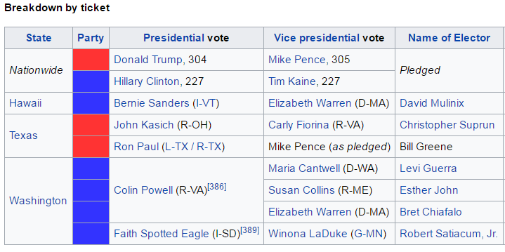
2016 Electroal Votes
12/19/2016 1/6/2017

Slide 20
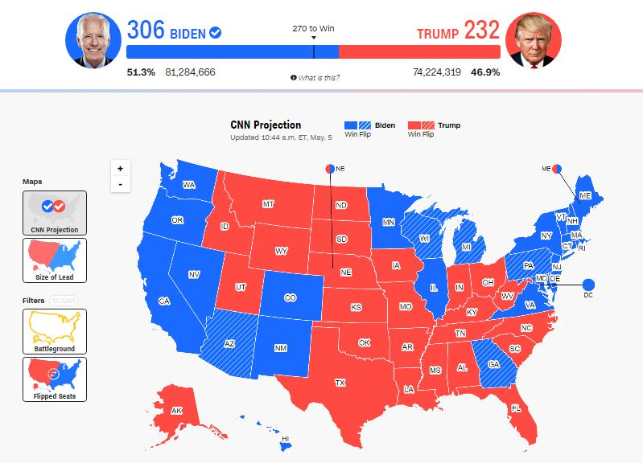
Election 2020 11/3/2020

Slide 21
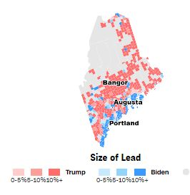
Maine 2020 4 Electoral Votes
Biden 3 Trump 1

Slide 22
Maine 2020
The DEMOCRATIC PARTY Electors supporting the candidacy of Joseph R. Biden for President and Kamala D. Harris for Vice President received the following votes:
First Congressional District Jay Philbrick, North Yarmouth 266,376 ★
Second Congressional District Betty Johnson, Lincolnville 168,696
At-Large David Bright, Dixmont 435,072 ★
At-Large Shenna Bellows, Manchester 435,072 ★
The GREEN INDEPENDENT PARTY Electors supporting the candidacy of Howard Hawkins for President and Angela Nicole Walker for Vice President received the following votes:
First Congressional District Justin Beth, Portland 4,654
Second Congressional District Benjamin Meiklejohn, Mount Desert 3,576
At-Large Kelly Merrill, Portland 8,230
At-Large Jake Kulaw, South Portland 8,230
The REPUBLICAN PARTY Electors supporting the candidacy of Donald J Trump for President and Michael R. Pence for Vice President received the following votes:
First Congressional District Demitroula Kouzounas, Saco 164,045
Second Congressional District Peter LaVerdiere, Oxford 196,692 ★
At-Large Ellie Espling, New Gloucester 360,737
At-Large Joshua Tardy, Newport 360,737

Slide 23
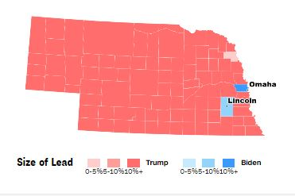
Nebraska 2020 5 Electoral Votes
Trump 4 Biden 1

Slide 24
Nebraska 2020
Republican Party Donald J. Trump, President / Michael R. Pence, Vice President
Statewide Total Votes Received: 556,846
Electors:
Darlene Starman, 8132 Hickory Ln, Lincoln, NE 68510 (At Large) ★
Steve Nelson, 639 25 Rd, Axtell, NE 68924 (At Large) ★
First Congressional District Total Votes Received: 180,290 ★
George Olmer, 4241 Cripple Creek Rd, Lincoln, NE 68516 (1st District)
Second Congressional District Total Votes Received: 154,377
Mark Quandahl, 16729 Leavenworth Cir, Omaha, NE 68 l l 8 (2nd District)
Third Congressional District Total Votes Received: 222,179 ★
Teresa Ibach, 44670 Road 767, Sumner, NE 68878 (3rd District)
Democratic Party Joseph R. Biden, President / Kamala D. Harris, Vice President
Statewide Total Votes Received: 374,583
Electors:
Roger Wess, 1001 Maple St., Chadron, NE 69337 (At Large)
Peg Lippert, l l 12 Limerick Rd, Papillon, NE 68046 (At Large).
First Congressional District Total Votes Received: 132,261
Larry Wright, 5230 West Thatcher Lane, Lincoln, NE 68528 (1 st District)
Second Congressional District Total Votes Received: 176,468 ★
Precious McKesson, 6716 Nebraska Ave, Omaha, NE 68 l 04 (2nd District)
Third Congressional District Total Votes Received: 65,854
Kathy Moore Jensen, 1101 North Brass Ave, Juniata, NE 68955 (3rd District)

Slide 25
Nebraska 2020
Libertarian Party Jo Jorgensen, President / Jeremy Cohen, Vice President
Statewide Total Votes Received: 20,283
Electors:
Ben Backus, 440 0 St., Gering, NE 6934 l (At Large)
Laura Ebke, 1935 Saint Andrews Dr., Crete, NE 68333 (At Large)
First Congressional District Total Votes Received: 7,495
Trevor Reilly, 2436 C St., Apt. 1, Lincoln, NE 68502 (1 st District)
Second Congressional District Total Votes Received: 6,909
Margaret Austgen, 2728 N 64th St., Omaha, NE 68104 (2nd District)
Third Congressional District Total Votes Received: 5,879
Patrick Birkel, 214 S. Harrison St., Grand Island, NE 68803 (3n1 District)

